Slide 1
Plant health status monitoring and Tracking(INDOOR).
~ TEAM ECO INNOVATORS,
Bennett UNIVERSITY.

Slide 2
TEAM MEMBERS :
GAURAV KUMAR JAISWAL :E21CSEU0309
ANUSH DASARI REDDY :E21CSEU0270
C. KARTHIK :E21CSEU0264
Chitrakavi surya :E21CSEU0263
Srinivasa vamsee

Slide 3
WHY THIS MODEL?
The indoor plants are high in duty and the number of people buying indoor plants is increasing day by day. But people face a lot of problems in raising the indoor plants as taking care of these indoor plants is not easy and they even die with a cause which is difficult to predict.
According to the National Gardening Association people from all age groups ranging 20 and above are completely obsessed with indoor plants. It states that in the US alone the sale of indoor plants has incremented by 50% during the last three years which now stands at a value of $1.7 billion in 2019. The need of indoor plants is increasing day by day so is the problem to take care of these plants. To raise and maintain the health of the indoor plants there are various factors that need to be monitored which include- soil moisture, temperature, humidity, and soil pH.
OBJECTIVE OF OUR SOLUTIONS:
To provide easy access to the parameters affecting the crop fields from anywhere around the globe.
To control the wastage of irrigation water.
To replace the old time-consuming method of the irrigation system with an efficient automatic system.

Slide 4
METHODOLOGY:
Hardware Components:- 1)Arduino Uno; 2)NodeMCU ESP8266 WI-FI module; 3)Relay; 4)Mini Water Pump; 5)Soil Moisture Sensor; 6)DHT11 Sensor; 7)LDR Sensor; 8)pH sensor; 9)Water Level Sensor; 10)LiPo rechargeable battery.
Software Components:- 1)Arduino IDE Software; 2)BLYNK Application; 3)Thingspeak.
In order to achieve this solution, a relay module is interfaced to Node MCU board at the receiver end while on the transmitter end, a set point on the soil moisture sensor is considered. If the moisture of the soil falls below the set-point, the relay switches on and allows the mini-dc pump to conduct and supply water to the crop fields. Once the required moisture level is reached, the soil moisture sends the signal to the relay module via NodeMCU .The relay switches off and thus switching off the mini –dc pump. Also, the humidity and temperature of the atmosphere are measured using the DHT-11 sensor. Outputs are displayed on the BLYNK app as well as on Thingspeak cloud platform for future reference. The flow chart depicting the methodology. It shows how the control shifts from the soil moisture sensor to the pump depending upon whether the soil moisture is the same as required by the crop.

Slide 5
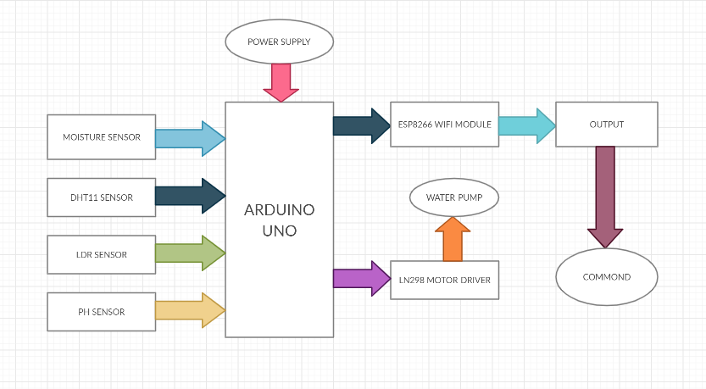
BLOCK DIAGRAM :
RELAY

Slide 6
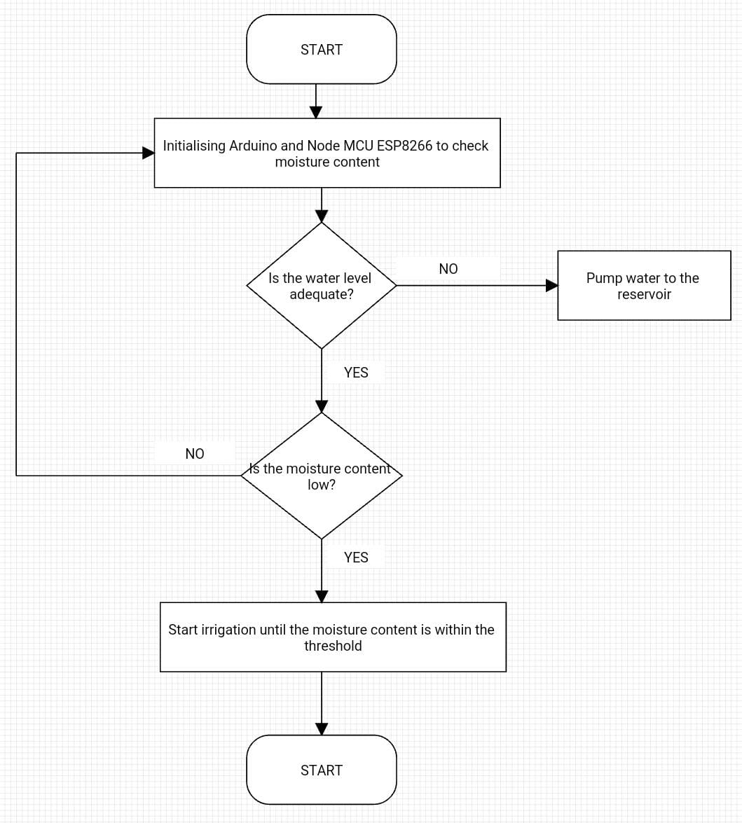
FLOWCHART :

Slide 7
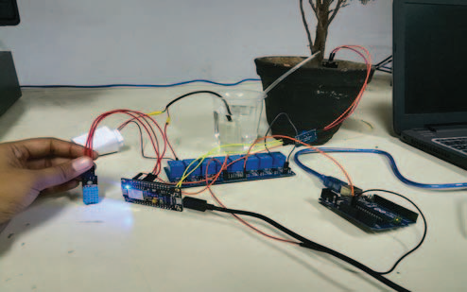
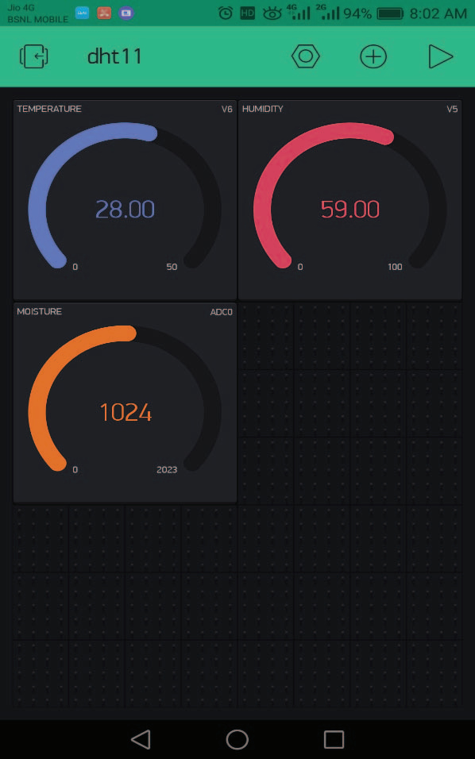
SIMULATION :

Slide 8
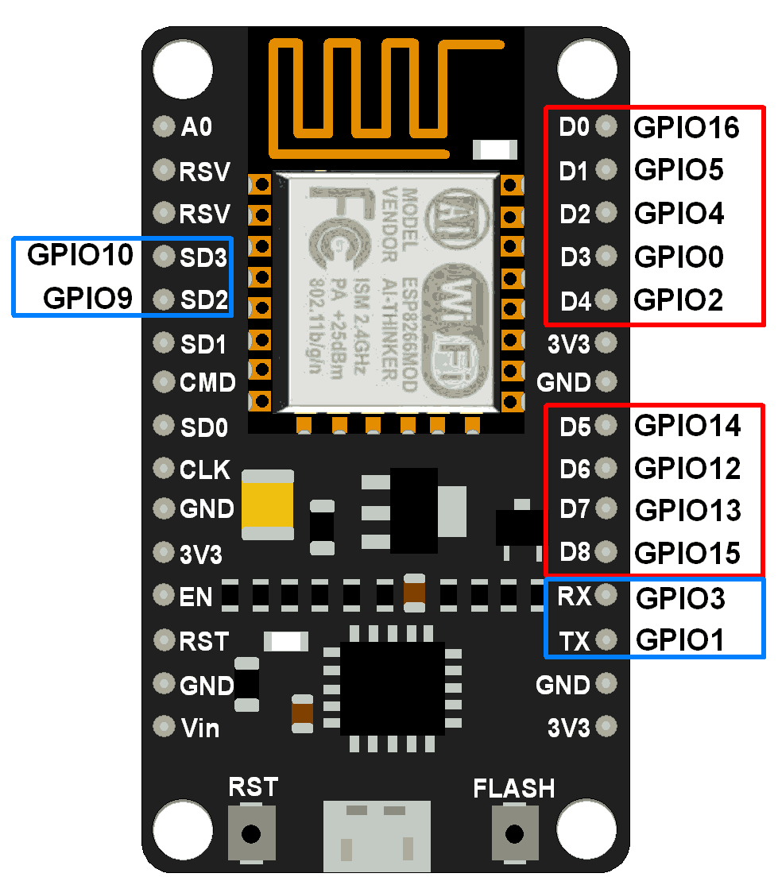
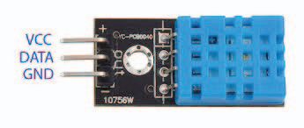
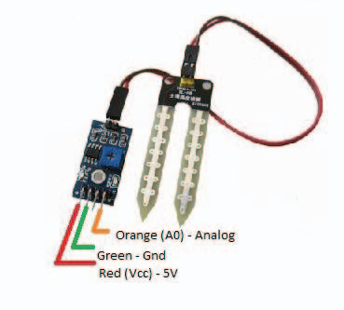
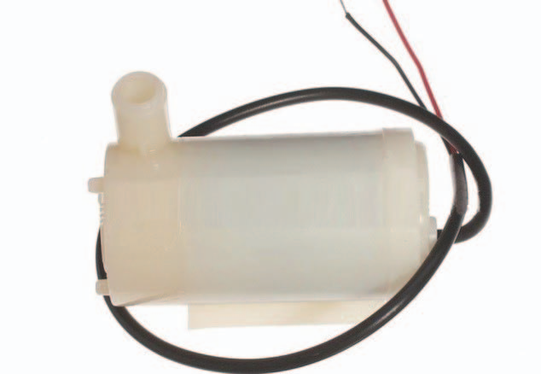
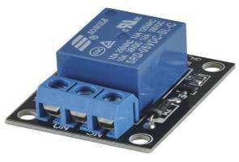
VARIOUS COMPONENTS USED :
DHT 11 Temperatue and Humidity Sensor
Soil moisture sensor
Mini-Water Pump
Relay
NodeMCU ESP8266 WI-FI MODULE

Slide 9
INNOVATIVE ASPECT:
The Arduino combined with the various sensors makes it possible for the plant to communicate with the user. It helps in curbing down the responsibility of the plant owner. So far, It will be successful in conducting the functions of uploading and retrieving the data. It carries all the tasks as stated in acting as a good monitoring system and helping in maintaining the good health of the plant. It helps in reducing the responsibility of the plant owners by proving automatic water supply in the right amount and constant reminders if the plant is in need. It also helps those plant owners who do not have the right knowledge to take care of the plant and might end up harming it. This will prevent many houseplants from dying by proper monitoring and maintaining of the houseplants. With the various components which come together in producing the output stated.

Slide 10


